Slide 1


Team 25-MSAMI
■Project
: Android App for HanYang University Student
■Team Member
Park Jae Yong
Kim Min Sang
Kim Dong Gyu

Slide 2

Contents
Member Introduce
App Introduce
Product and Result
Our Task(Develop & Problem)
Reference & License

Slide 3

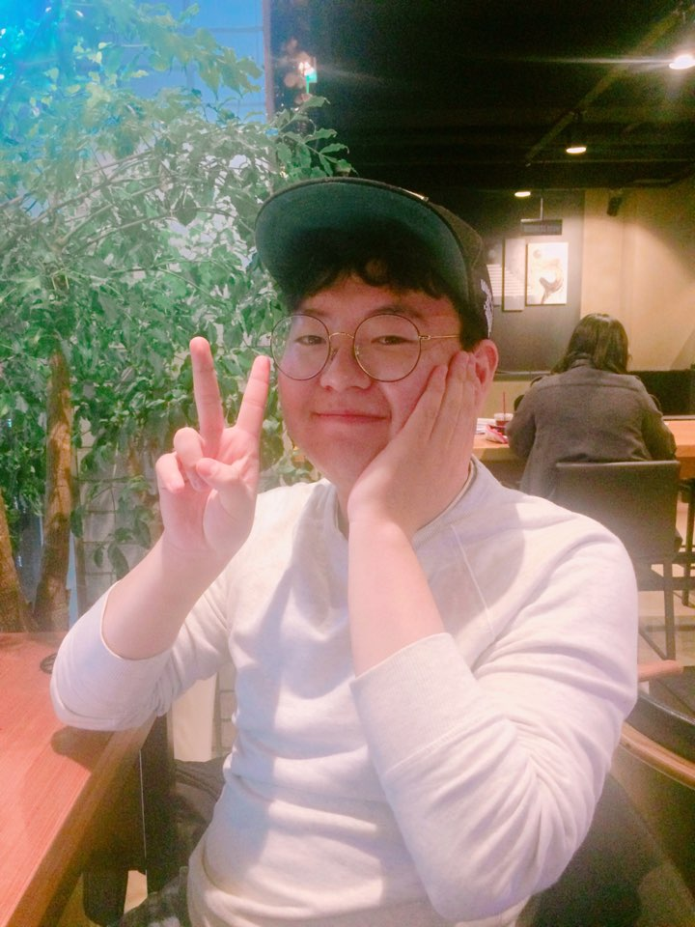

Member Introduce
Park Jae Yong
Developer and designer
Kim Dong Gyu
Making ppt and Document
Kim Min Sang
Main Developer and Designer

Slide 4



Already....
But!!!

Slide 5
Product and Result

Slide 6
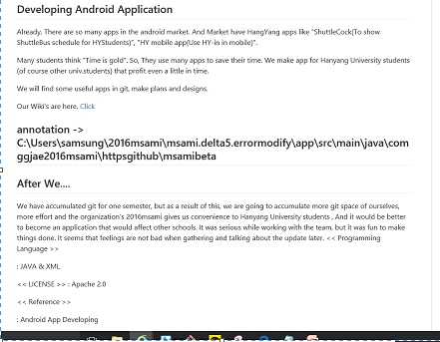
Outline & Using Language
Language :
JAVA & XML

Slide 7
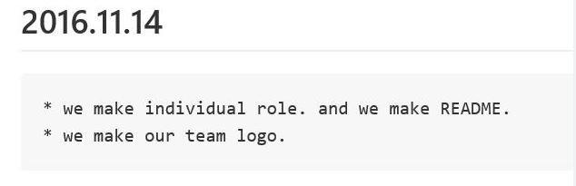
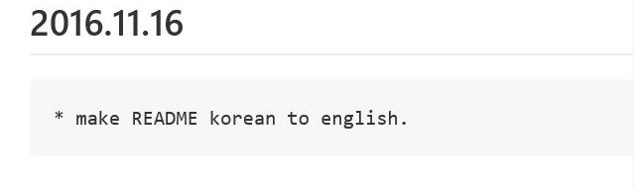
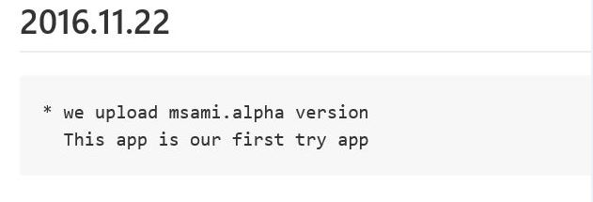
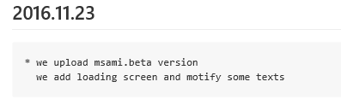
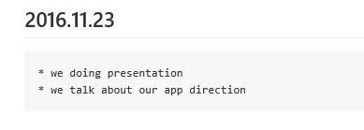
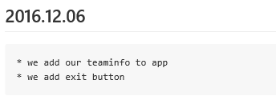
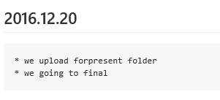
What We Have Done?
⊙Make Individual Role
⊙Make Outline
⊙Develop!
⊙Upload alpha version
⊙Make beta version
⊙Make Final version!

Slide 8
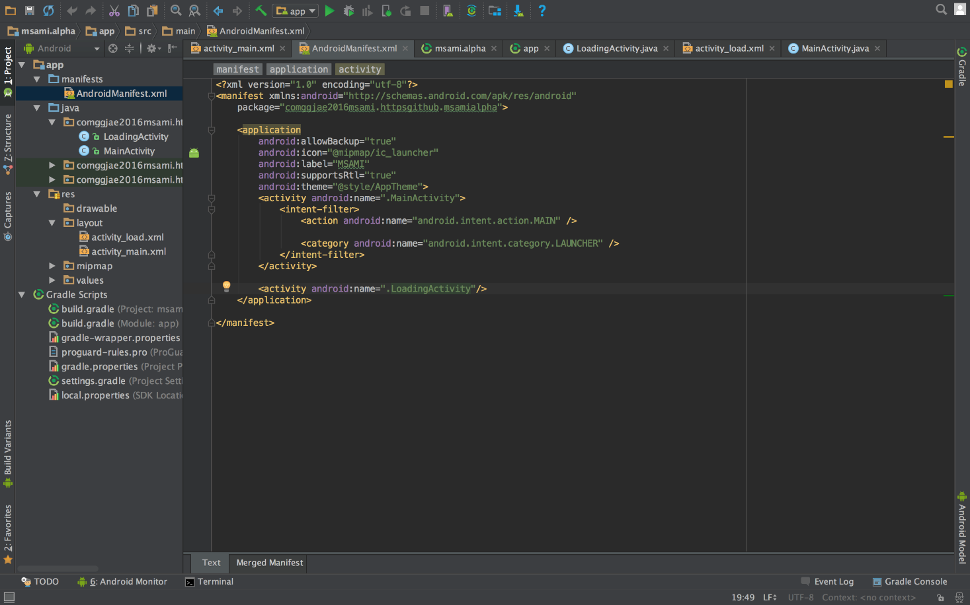
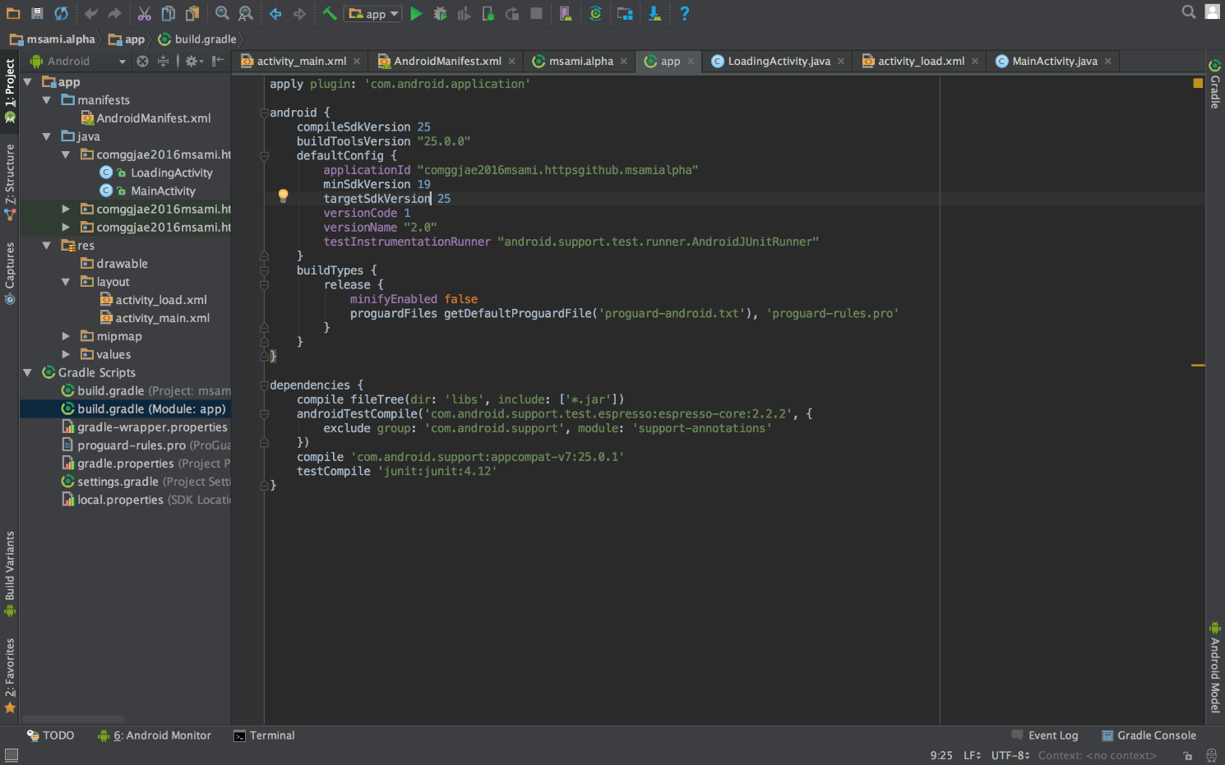
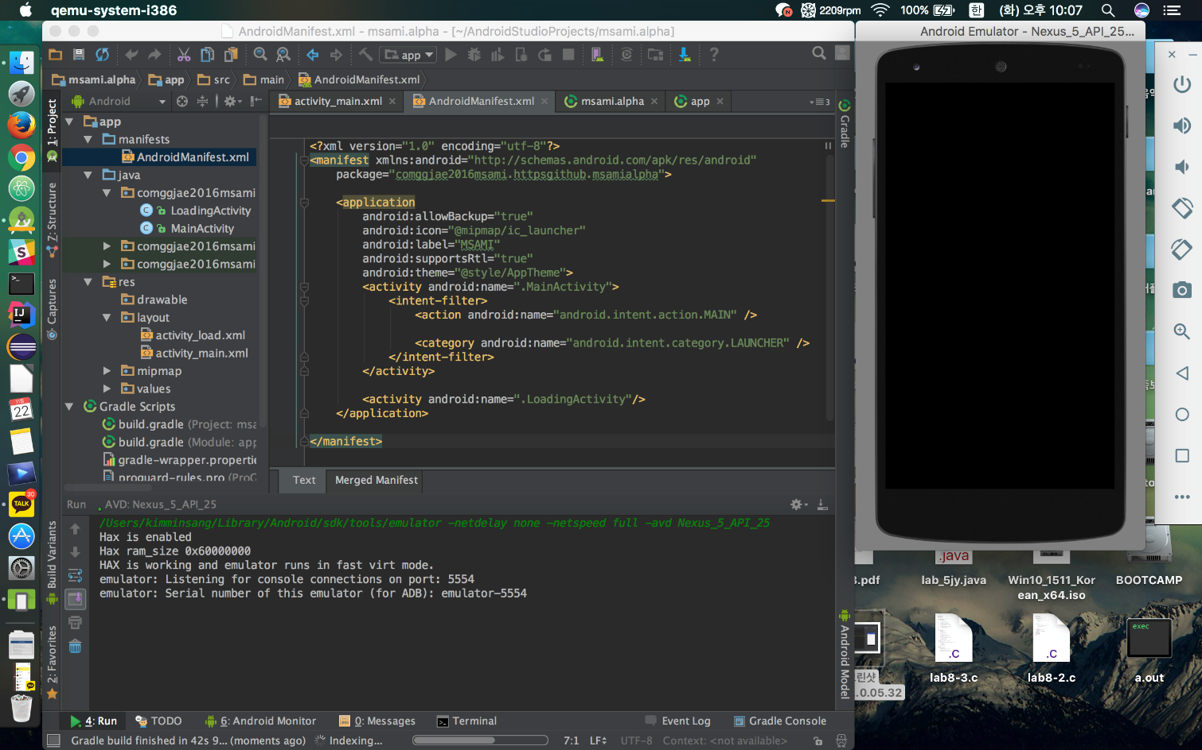
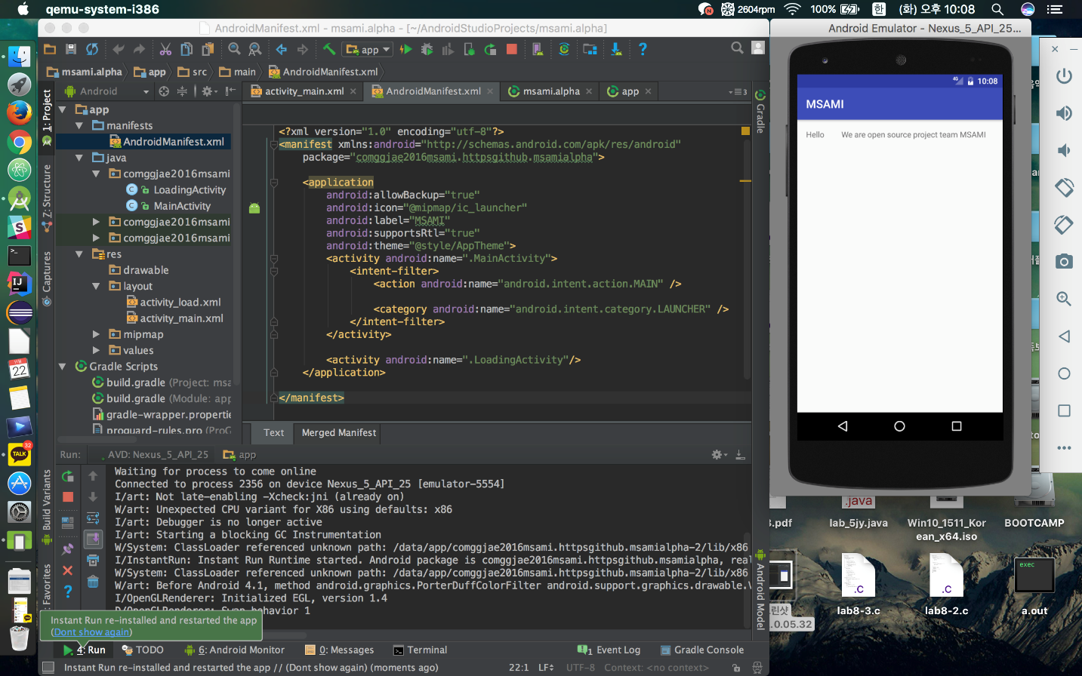
Develop Process

Slide 9
Problem
- Error Modify
- Image Extension error

Slide 10

Result!

Slide 11
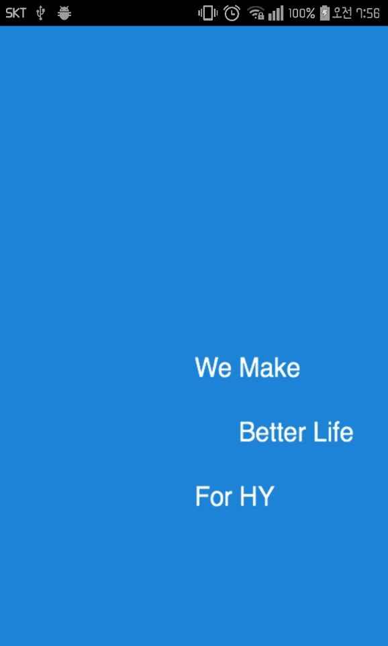
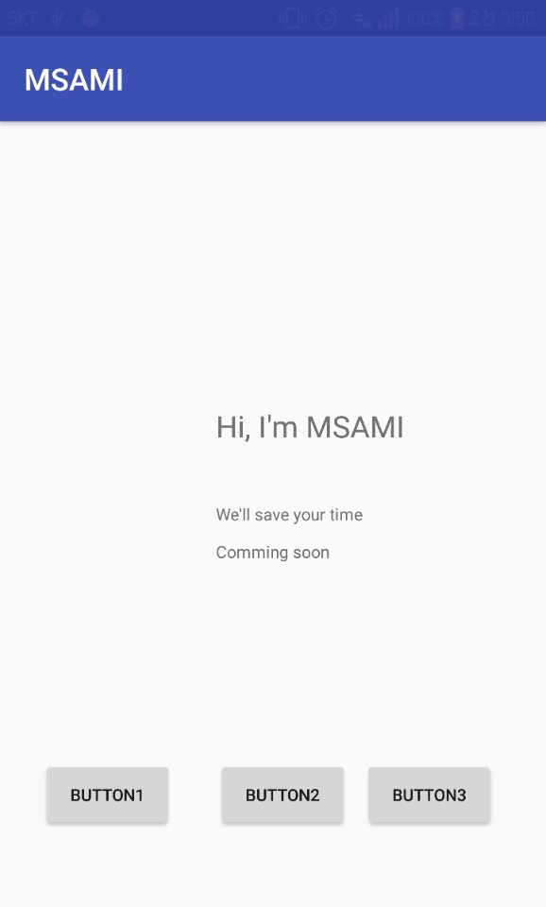
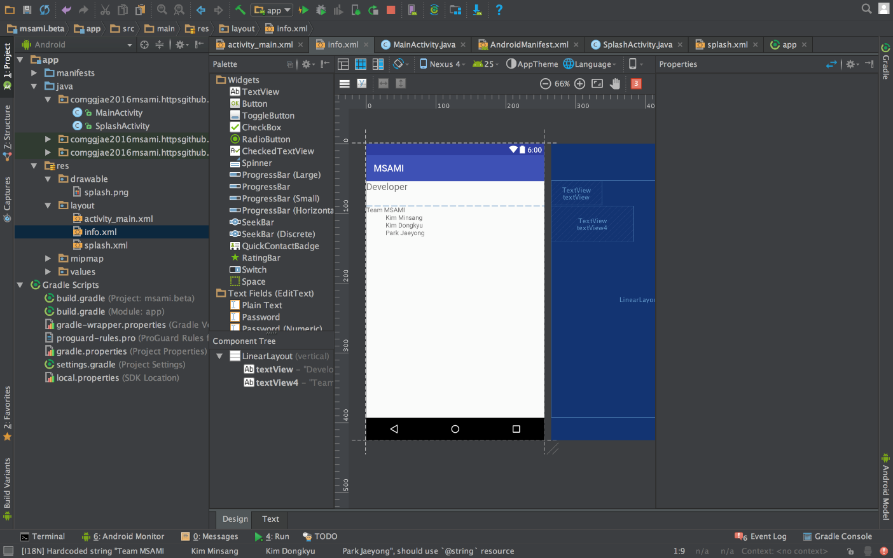
Mid-Result!

Slide 12
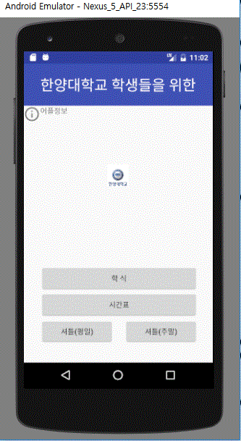
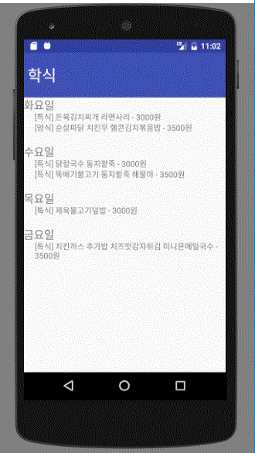
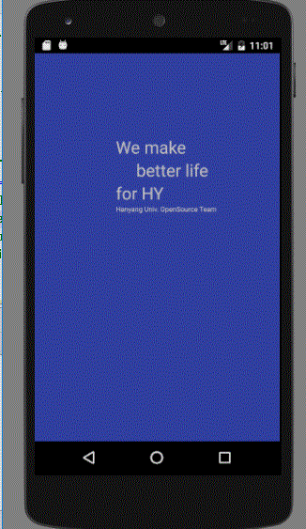
Final-Result!

Slide 13
Reference & License
Reference(lecture)
git\2016msami\reference.txt
License
- Apache 2.0

Slide 14
Thanks for watching! ☺

